Slide 1
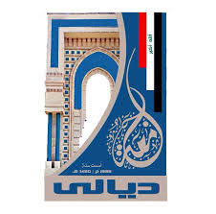
Electrical Circuit-I
6th Lecture

